Slide 1
K-Means Clustering of Individuals From A Loneliness Scale survey
Name: Shameek Bhowmick
Roll no.: 226524
Class: M.Sc. Data Science Sem 1

Slide 2
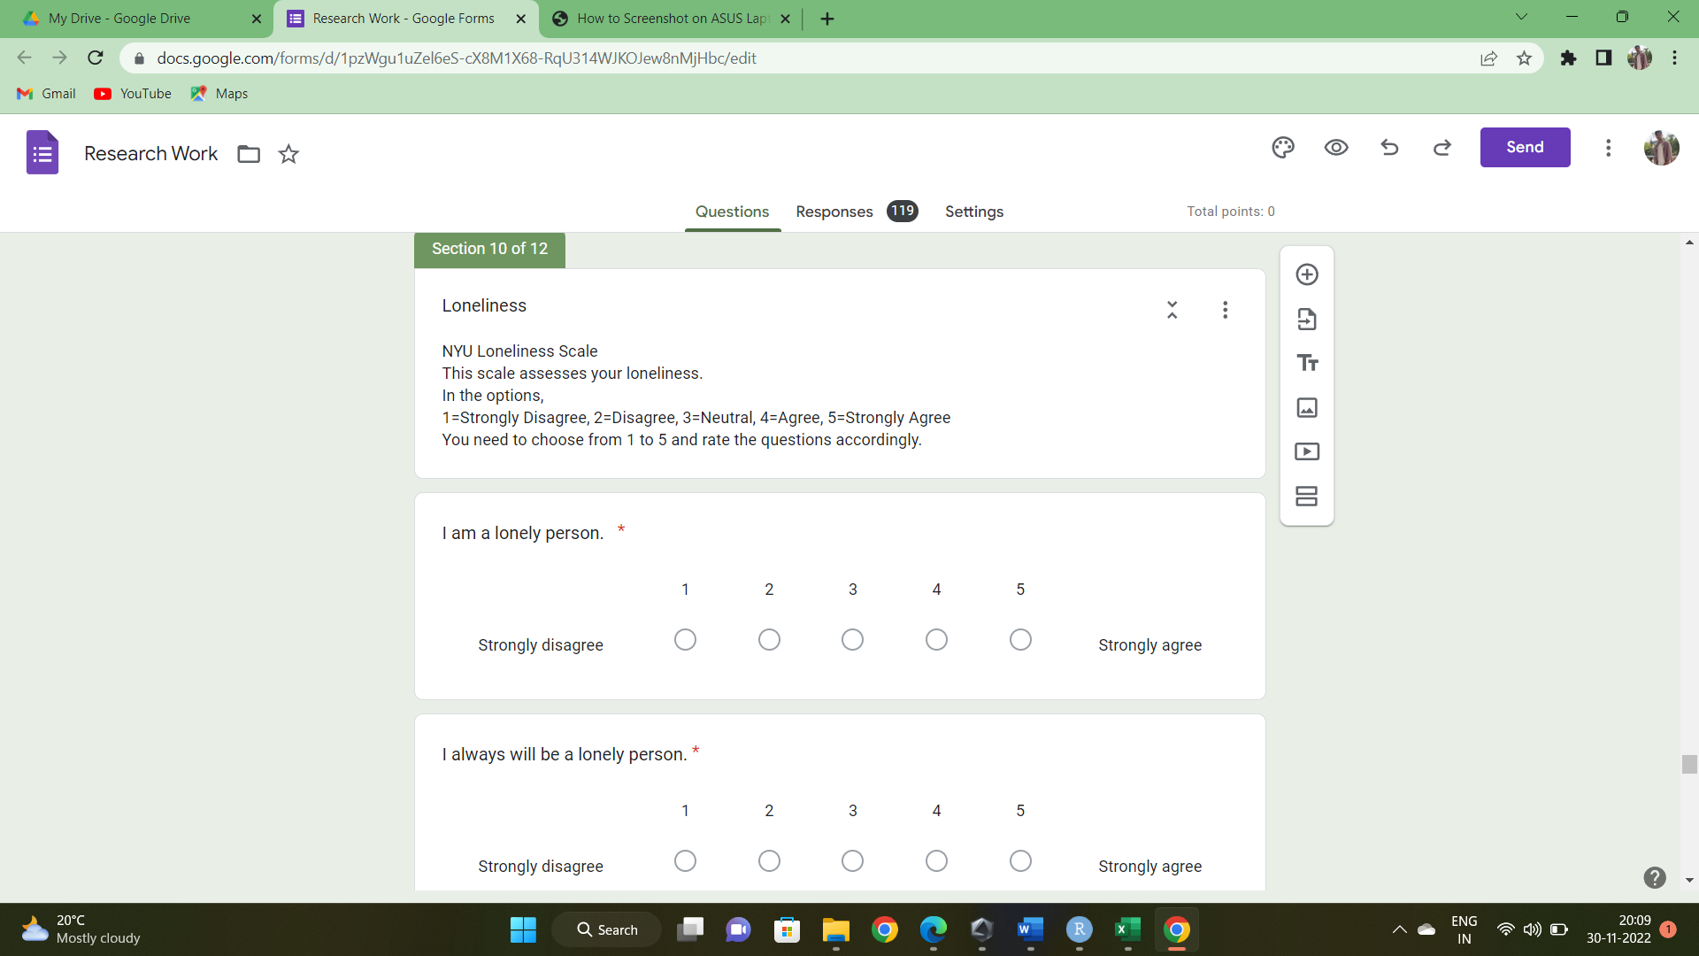
DATA COLLECTION
Information about the feeling of ‘loneliness’ was gathered through a google form distributed among peers and relatives.(Survey conducted during December, 2021)
The NYU Loneliness Scale (Rubenstein and Shaver, 1982) was administered to assess the loneliness of the participants.
The dataset consisted of many such scales as data was gathered for a bigger study but we only require the data from the questions related to the Loneliness Scale.
The questions and the respective numerical coding of the responses is given below:-

Slide 3
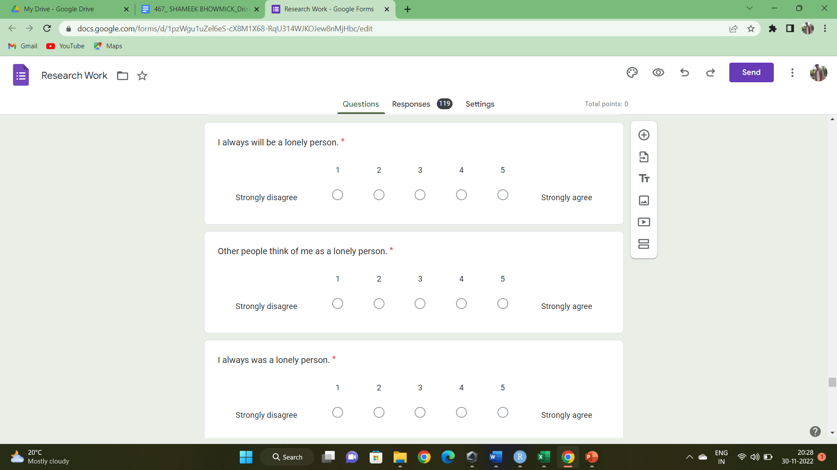
A total of N=118 individuals (80 males, 38 females) participated in the study.

Slide 4
A few data points from the responses is given below (To keep the identity of the individuals anonymous we take the vectors only as “observation no.”) :-
Observation No. | Question 1 | Question 2 | Question 3 | Question 4
1 | 4 | 4 | 4 | 2
2 | 2 | 2 | 3 | 3
‘ ‘ ‘ | . . . | . . . | . . . | . . .
117 | 3 | 3 | 3 | 3
118 | 1 | 3 | 1 | 3

Slide 5
K-MEANS ALGORITHM AND THE CLUSTERS
We perform the K-Means Algorithm to form k groups/clusters of the data where vectors in each group are similar to each other.
Since there are 4 questions in the scale, the responses by each individual is a 4-vector.
There are 118 observations/individuals hence there are N=118 such 4-vectors.
To get the optimum value of k for our data we plot a graph of Total within sum of squares for each k vs k values.
The middle corner of the elbow shaped curve is picked and the corresponding k value is selected.
From the graph given below we select k=3 :-

Slide 6
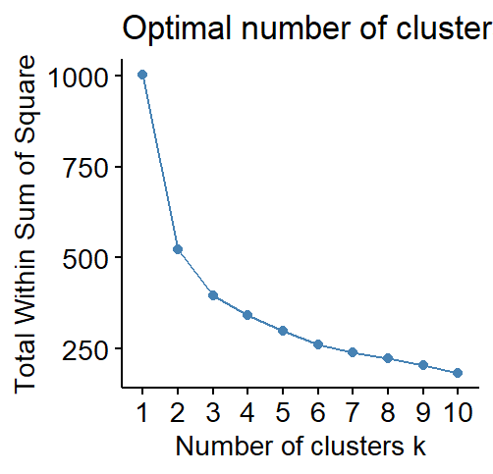

Slide 7
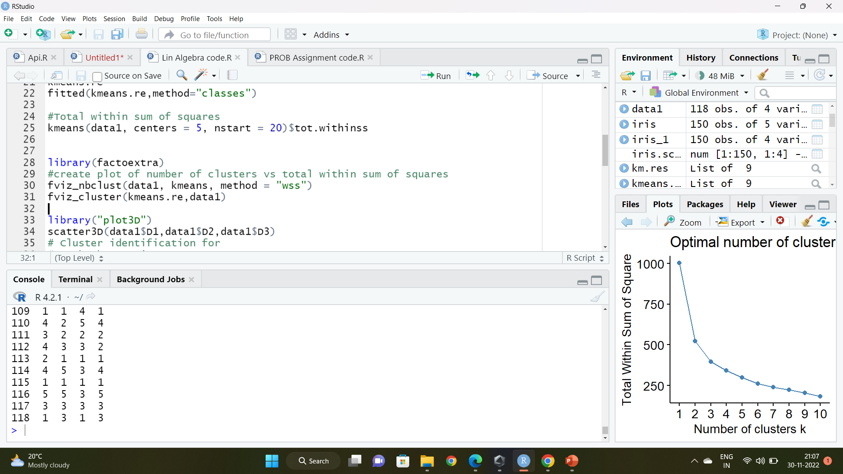
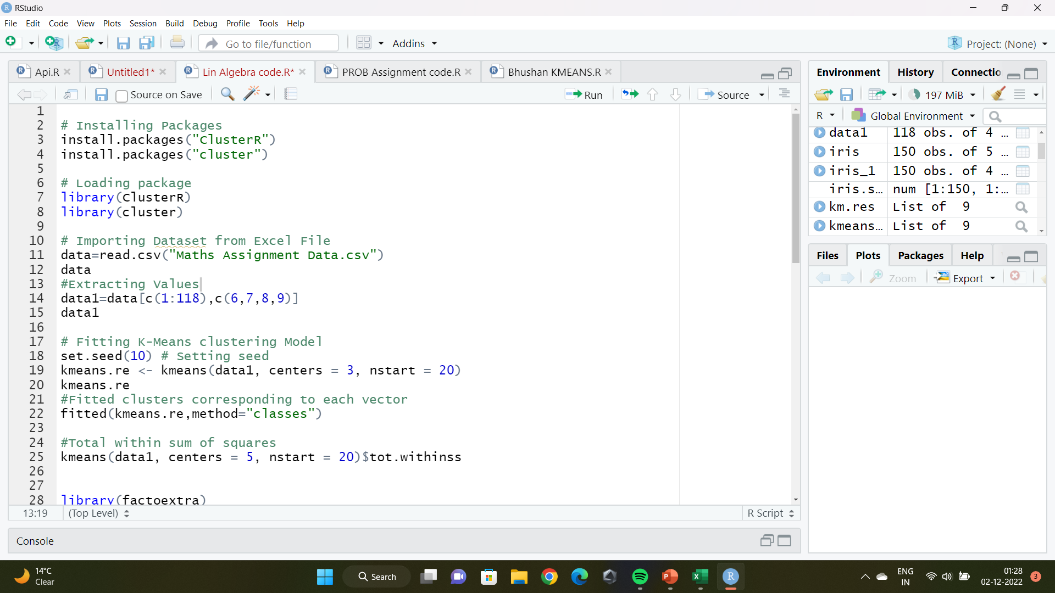
The R code for the plotting the graph is given below :-
Having found the suitable k value for the algorithm, we perform the K-Means Algorithm.
We use R software to perform the algorithm. The code is as follows :-

Slide 8
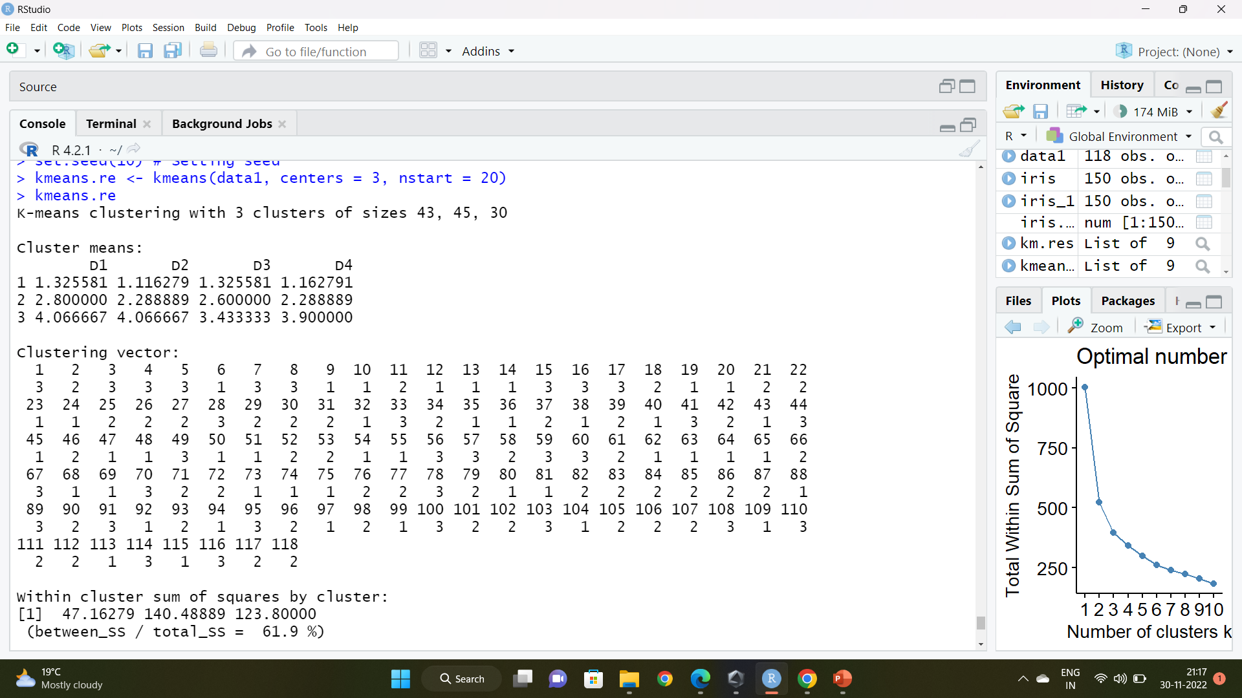
The output of the R code is given as :-
Note that in the clustering vector section, the top values are the vector numbers and right below that are the respective clusters they are placed in.

Slide 9
The vectors grouped according to their clusters are given below:-
Cluster Number | Vectors/Observations
1 (C1) | (1,1,1,1),(1,1,1,1),(2,1,2,1),(1,1,1,1),(1,1,1,1),(1,1,1,1),(1,1,1,1),(1,1,1,1),(3,2,1,1), (1,2,2,1),(2,1,1,1),(1,1,1,1),(1,1,3,2),(1,1,1,1),(1,1,1,1),(1,1,1,2),(1,1,1,1),(1,1,1,1), (1,1,1,1),(1,1,3,1),(1,1,1,1),(1,1,1,1),(1,1,1,3),(1,1,2,1),(3,1,2,1),(1,1,1,1),(1,1,1,1), (2,2,1,1),(2,1,1,3),(1,1,1,1),(1,1,1,1),(1,2,1,1),(2,1,2,1),(2,1,2,1),(1,1,1,1),(1,1,2,1), (2,1,1,1),(2,2,1,2),(1,1,1,1),(2,1,1,1),(1,1,4,1),(2,1,1,1),(1,1,1,1)
2 (C2) | (2,2,3,3),(3,2,3,4), (3,1,1,5),(2,2,2,2),(3,3,3,3),(3,3,4,3),(4,2,2,3),(2,1,1,4),(4,4,1,2), (3,2,2,4),(4,3,3,2),(3,3,2,1),(4,2,2,2),(3,1,3,1),(2,2,4,2),(3,3,4,3),(2,2,2,2),(3,2,2,1), (2,2,2,2),(2,2,3,2),(4,4,1,1),(4,3,3,2),(2,2,3,2),(2,2,3,3),(2,1,4,1),(2,2,2,2),(3,3,5,2), (3,2,1,2),(2,3,2,2),(2,1,4,1),(3,2,2,2),(3,3,5,1),(3,2,2,2),(3,2,4,2),(3,3,2,4),(2,2,2,2), (3,1,3,1),(3,2,1,2),(3,3,3,3),(2,2,4,3),(4,3,3,2),(3,2,2,2),(4,3,3,2),(3,3,3,3),(1,3,1,3)
3 (C3) | (4,4,4,2),(5,5,5,5),(4,3,4,4),(5,5,5,5),(4,3,2,4),(5,5,5,1),(4,4,2,4),(5,4,3,2),(4,3,5,4), (3,4,2,4),(3,3,2,5),(4,3,2,4),(3,5,2,5),(1,3,5,5),(5,5,2,4),(4,4,4,4),(4,4,2,3),(5,5,2,5), (5,5,5,2),(4,4,3,4),(5,5,5,5),(4,3,3,3),(4,5,4,4),(4,4,3,4),(5,5,5,5),(3,4,3,3),(3,3,3,4), (4,2,5,4),(4,5,3,4),(5,5,3,5)

Slide 10
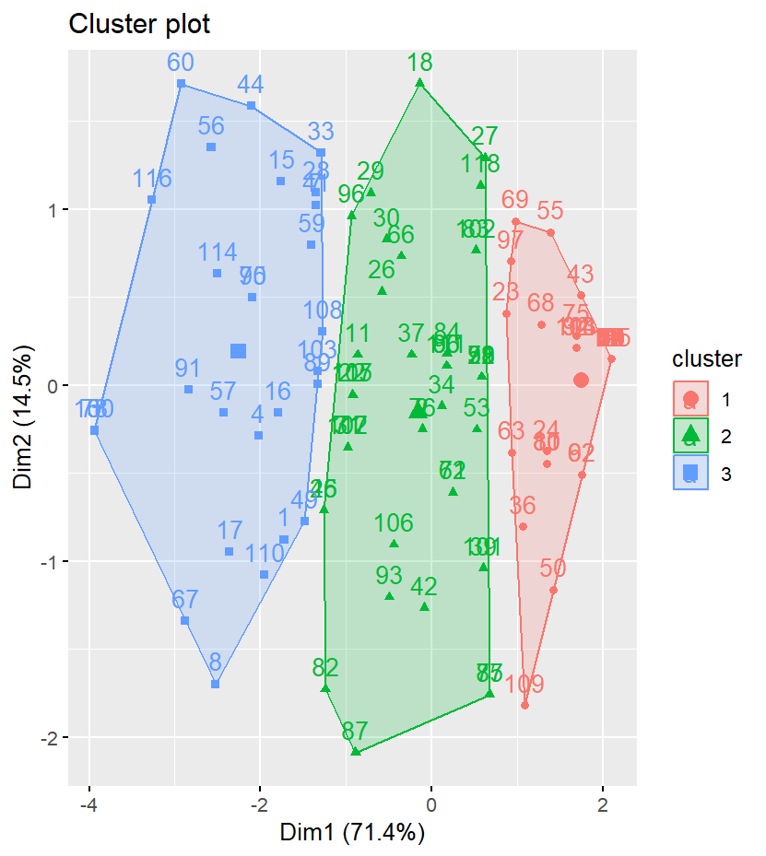
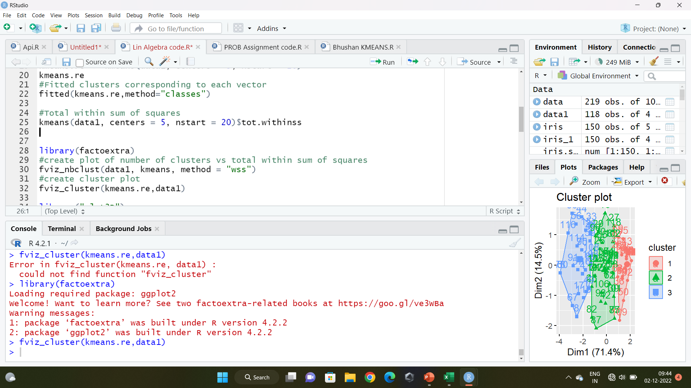
The R code for the cluster plot is given below :-

Slide 11
CONCLUSION
We also see from the plotted graph that k=5 is a viable cluster number but the decrease in total within sum of squares isn’t significant enough.
Cluster 1 (C1) contains the vectors {(1,1,1,1),(2,1,2,1),…….} which are pretty low scores in the Likert scale which depicts that these individuals feel that they aren’t so lonely.
Hence, individuals in Cluster 1 feel that they have a low level of Loneliness.
Cluster 2 (C2) contains the vectors {(2,2,3,3),(3,2,3,4),…….} which are more or less neutral scores in the Likert scale which depicts that these individuals feel that their loneliness is fairly moderate.
Hence, individuals in Cluster 2 feel that they have a moderate level of Loneliness.
Cluster 3 (C3) contains the vectors {(4,4,4,2),(5,5,5,5),…….} which are pretty high scores in the Likert scale which depicts that these individuals feel that they are quite lonely.
Hence, individuals in Cluster 3 feel that they have a high level of Loneliness.

Slide 12
REFERENCES
Rubenstein, C., and Shaver, P. R. (1982). “The experience of loneliness,” in Loneliness: A Sourcebook of Current Theory, Research, and Therapy, eds L. A. Peplau and D. Perlman (New York, NY: Wiley-Interscience), 206–223.
Link for the questionnaire :- https://forms.gle/bdMDdSuCzFa7A6W89
Kalyani Ma’ams Notes.

